Slide 1
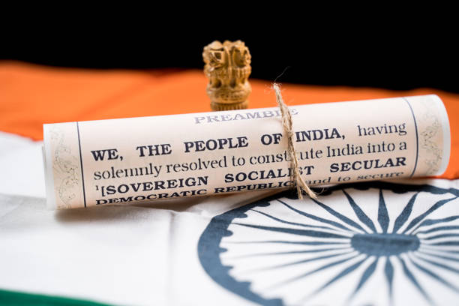
The Constitution of India
The Supreme Law of the Land

Slide 2

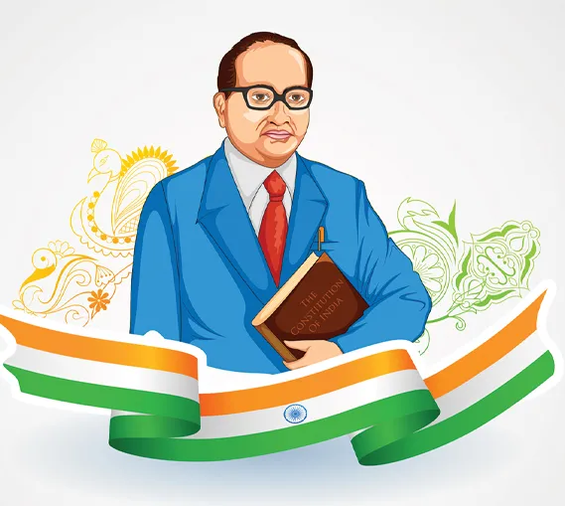
Introduction
Adopted on 26th November 1949
Enforced from 26th January 1950
World’s lonest written constitution
Defines Rights, Duties & Governance

Slide 3

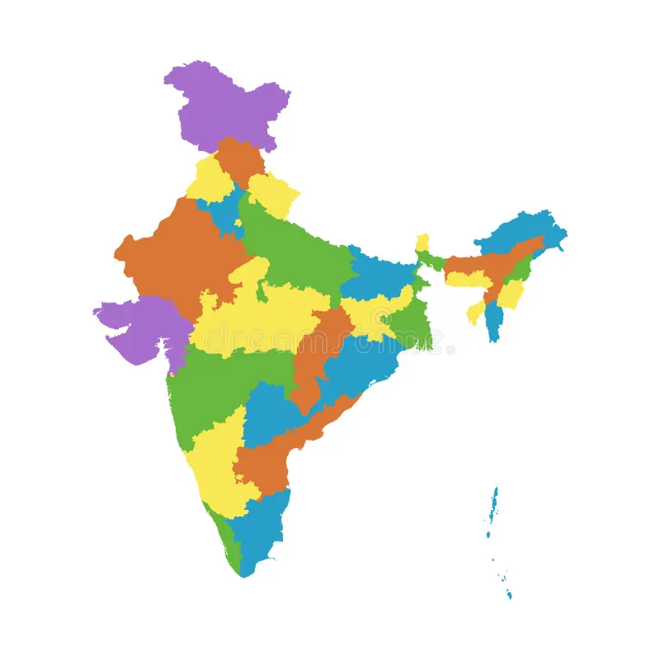
Features if Indian Constitution
Written & Detailed Document
Parliamentary System of Government
Federal with Unitary Bias
Independent Judiciary
Secularism & Socialism

Slide 4

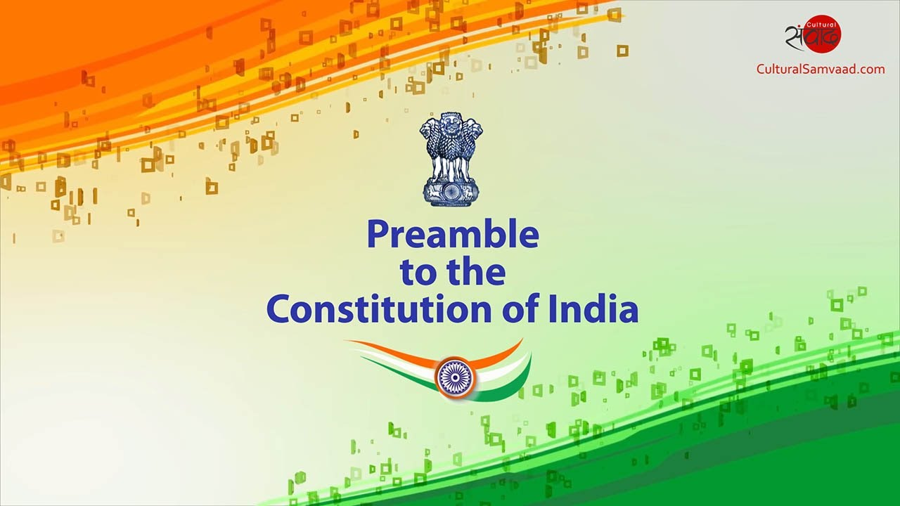
Preamble
Represents soul of the Constitution
Starts with ‘We, the People of India’
Promises: Justice, Liberty, Equality & Fraternity
Declares India as Sovereign, Socialist, Secular, Democratic Republic

Slide 5

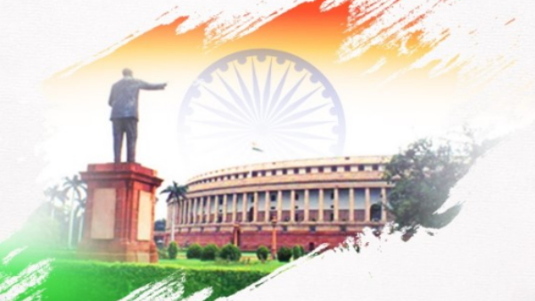
Parts & Schedules
25 parts & 12 Schedules
Covers areas like Fundamental Rights, DPSPs, Panchayati Raj, etc
Important Schedules:
A)- 8th Schedule: Languages
B)- 10th Schedule: Anti-defection
C)- 12th Schedule: Municipalities

Slide 6

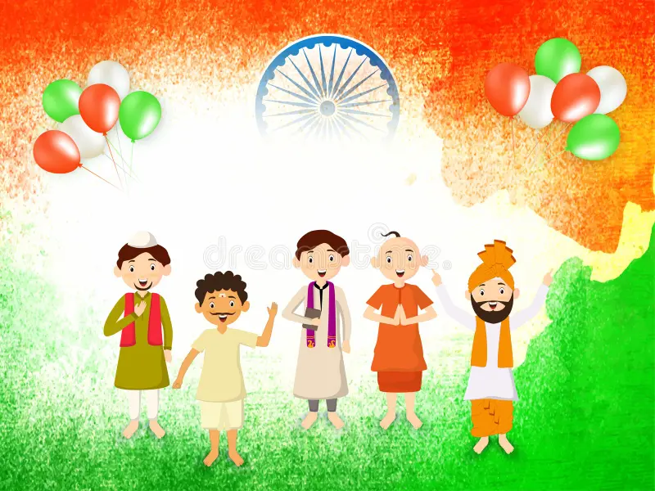
Fundamental Rights
Guaranteed to all citizens
6 Categories:
1. Right to Equality
2. Right to Freedom
3. Right against Exploitation
4. Right to Freedom of Religion
5. Cultural & Educational Rights
6. Right to Constitutional Remedies

Slide 7

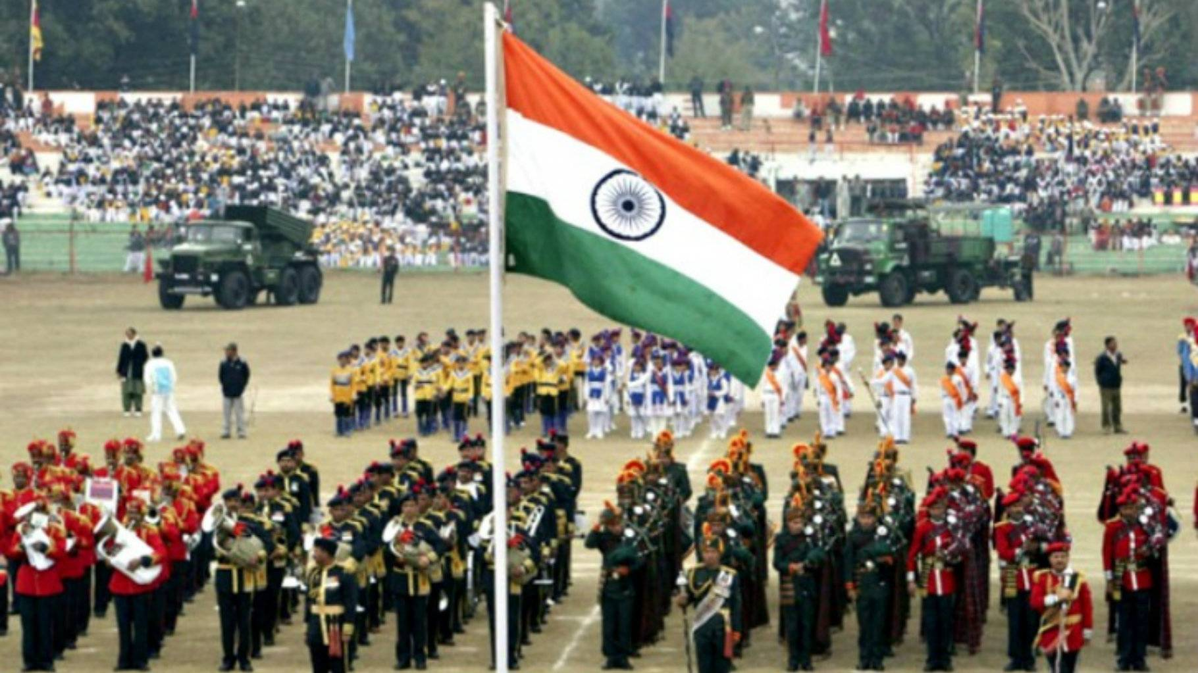
Fundamental Duties
Added by 42nd Amendment (1976)
Total 11 Duties
Promote patriotism & discipline
Examples:
1. Respect Constitution, National Flag & Anthem
2. Protect environment & heritage

Slide 8


Directive Principles of State Policy (DPSPs)
Guidelines for Government
Aim: Social & Economic Democracy
Non-justiciable but essential
Focus on:
Welfare state
Equal pay, free education, public health

Slide 9

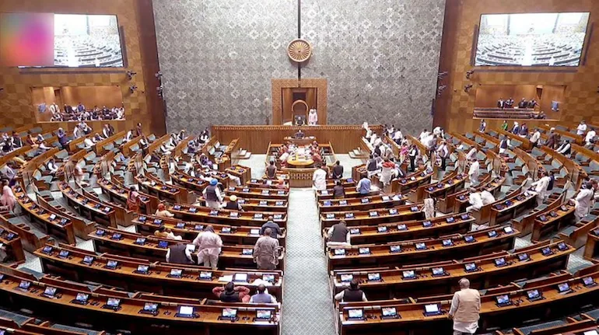
Amendment Process
Flexible & Rigid
Three types of amendment:
1. Simple Majority
2. Special Majority
3. Special Majority + State Ratification
Example: GST Act (101st Amendment)

Slide 10

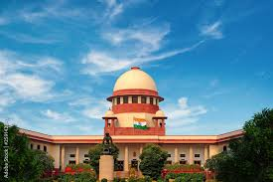
Judiciary & Constitution
Supreme Court: Guardian of Constitution
Judicial Review
Public Interest Litigations (PILs) allowed
Ensures fundamental rights protection

Slide 11

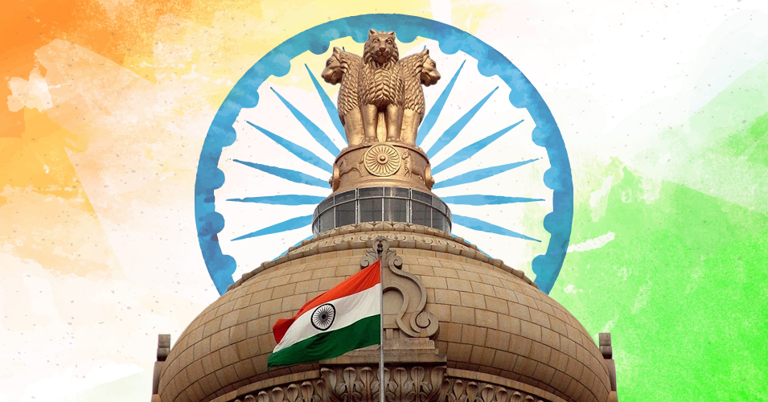
Important Amendments
1st Amendment (1951): Freedom Restrictions
42nd Amendment (1976): Mini-Constitution
44th Amendment (1978): Restored Rights
73rd & 74th Amendments: Local Self-Government

Slide 12

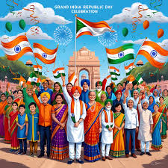
Conclusion
Constitution = Backbone of Democracy
Safeguards Unity, Liberty & Justice
Every citizen should be aware & responsible
‘Constitution is not a mere lawyer’s document, it is a vehicle of life’- Dr. B.R.Ambedkar

Slide 13

Thank You

